Slide 1


NeuroFleetX:
AI Powered Urban Fleet & Traffic Intelligence
by Chitta Gayatri Ritika Sri
Team B

Slide 2
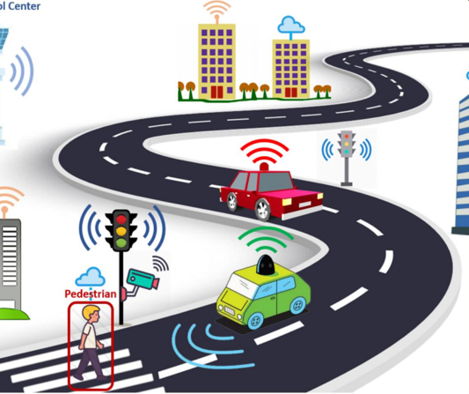
Project Overview
AI Powered Urban Fleet & Traffic Intelligence
A full-stack, AI driven ecosystem designed to revolutionize how urban fleets operate, By leveraging real time data and predictable models, NeuroFleetX transforms raw metrics into actionable intelligence
Optimizes: Operations, Traffic monitoring, Risk detection
Key Users: Admin, Fleet Manager, Driver
Core Value: Real time data + AL Predictions

Slide 3
Fleet Manager Module
Monitor
Analyze
Decide
Gain complete visibility with live fleet status tracking, real-time traffic congestion heatmaps, and identification of risk-prone locations instantly.
Deep dive into critical alerts,
monitor fuel efficiency across the fleet, and predict
maintenance needs before
breakdowns occur.
Make informed decisions to
enhance safety protocols,
optimize route planning
dynamically, and execute traffic control measures.

Slide 4
My Role: Manager Frontend
Designing UI
Crafted the intuitive Fleet Manager Interface for optimal
user experience.
Developing
Built the Manager dashboard, fleet overview screens, and
traffic management controls.
Integrating
Connected frontend with Spring
Boot APIs for seamless data flow.
Implementing
Enabled real-time updates, notifications, and secure JWT
API calls.

Slide 5

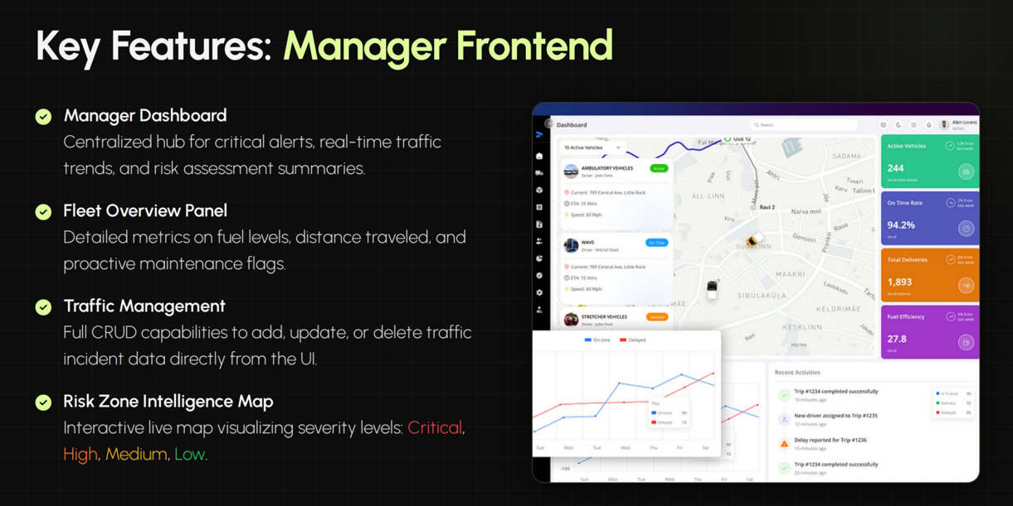
Key Features: Manager Frontend
Manager Dashboard
Centralized hub for critical alerts, real-time traffic
trends, and risk assessment summaries.
Fleet Overview Panel
Detailed metrics on fuel levels, distance traveled, and proactive maintenance flags.
Traffic Management
Full CRUD capabilities to add, update, or delete traffic incident data directly from the UI.
Risk Zone Intelligence Map
Interactive live map visualizing severity levels: Critical, High, Medium, Low.

Slide 6


Technologies: The Stack
Frontend
Core: React (Vite)
Styling: Tailwind CSS
Visualization: Recharts, React Leaflet
Communication: Axios
UI/UX: Lucide Icons, React Toastify
Backend Integration
Framework: Java Spring Boot
Security: Spring Security + JWT
Data: Spring Data JPA
04

Slide 7
THANK YOU

